Slide 1
C++
Formative Assignment

Slide 2
Some notes for the assignment
Assignment – due in on <decide date here>
Worksheet
Formative

Slide 3
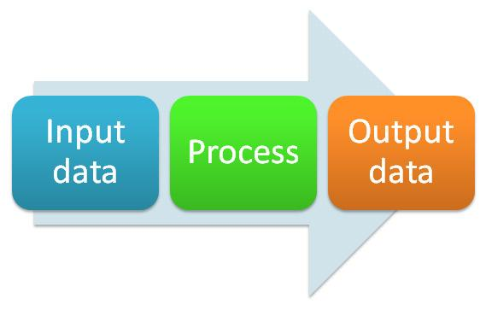
Input Process Output chart
What data items are input
What processing takes place on the data
What information will be the end result – the output

Slide 4
IPO chart
Input | Processing | Output
a | Enter first integer – a | Mean average
b | Enter second integer - b | Maximum number
c | Enter third integer - c
 | Calculate the mean
 | Calculate the maximum number

Slide 5
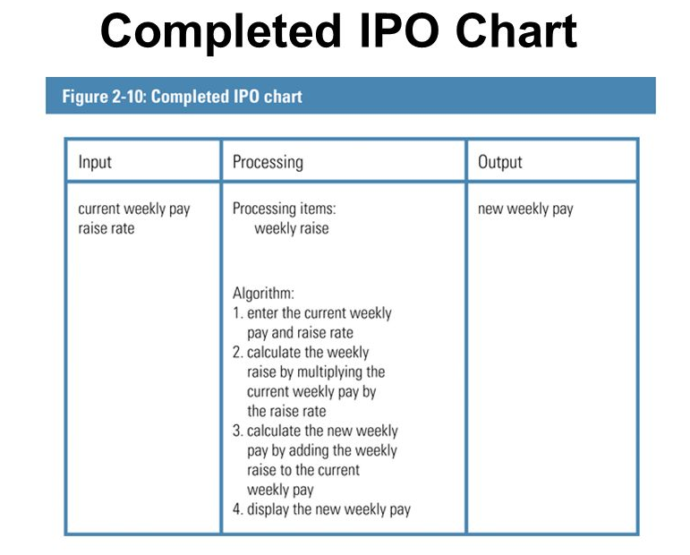

Slide 6
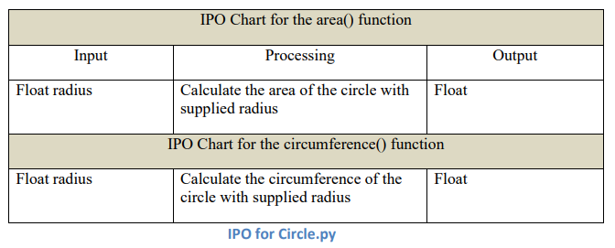

Slide 7
Some notes for the assignment
Assignment – due in on DATE HERE
Worksheet
Formative

